Slide 1

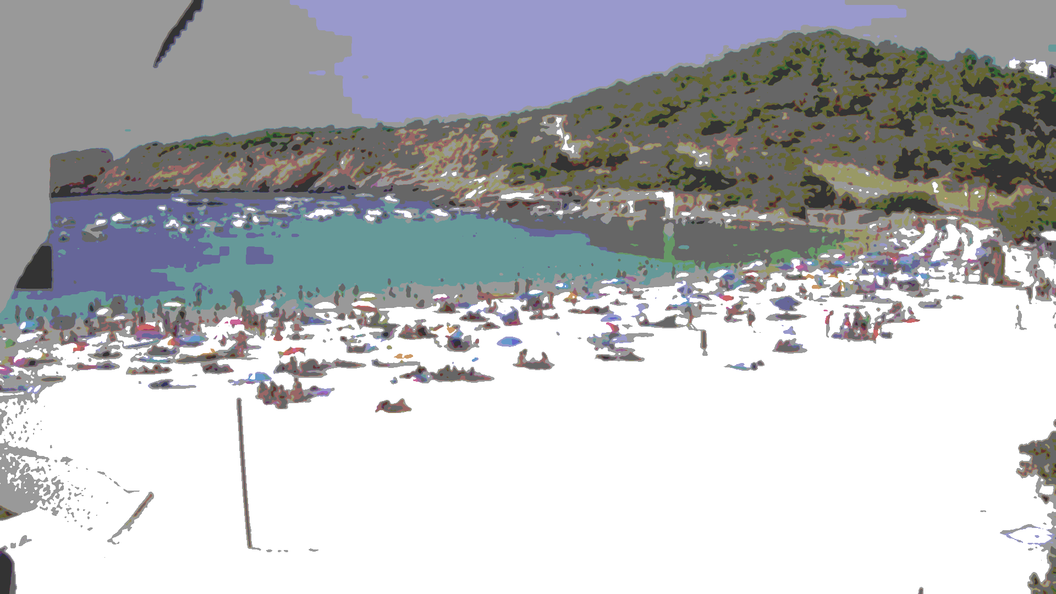
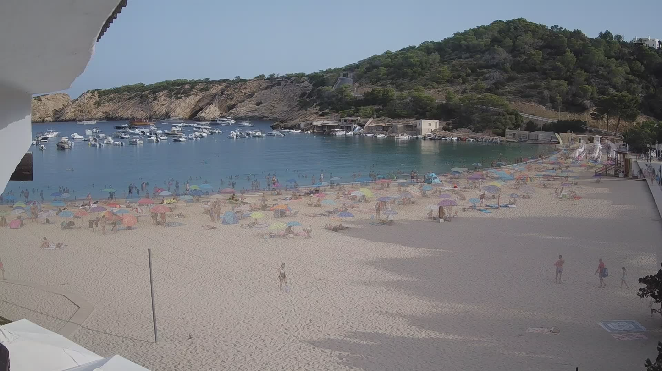
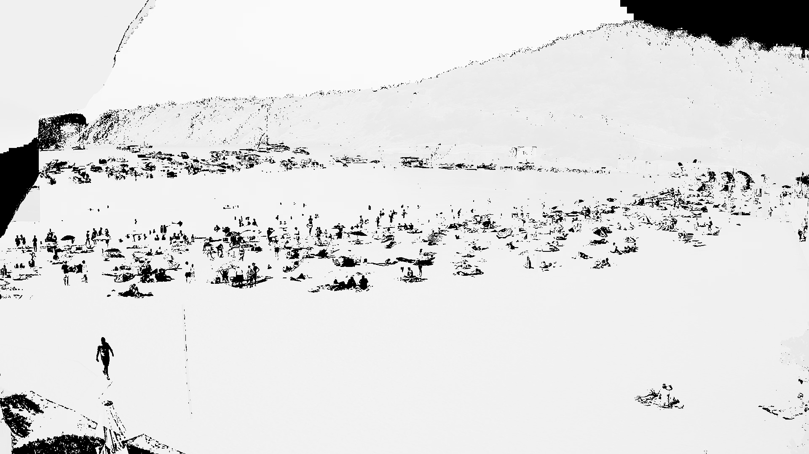
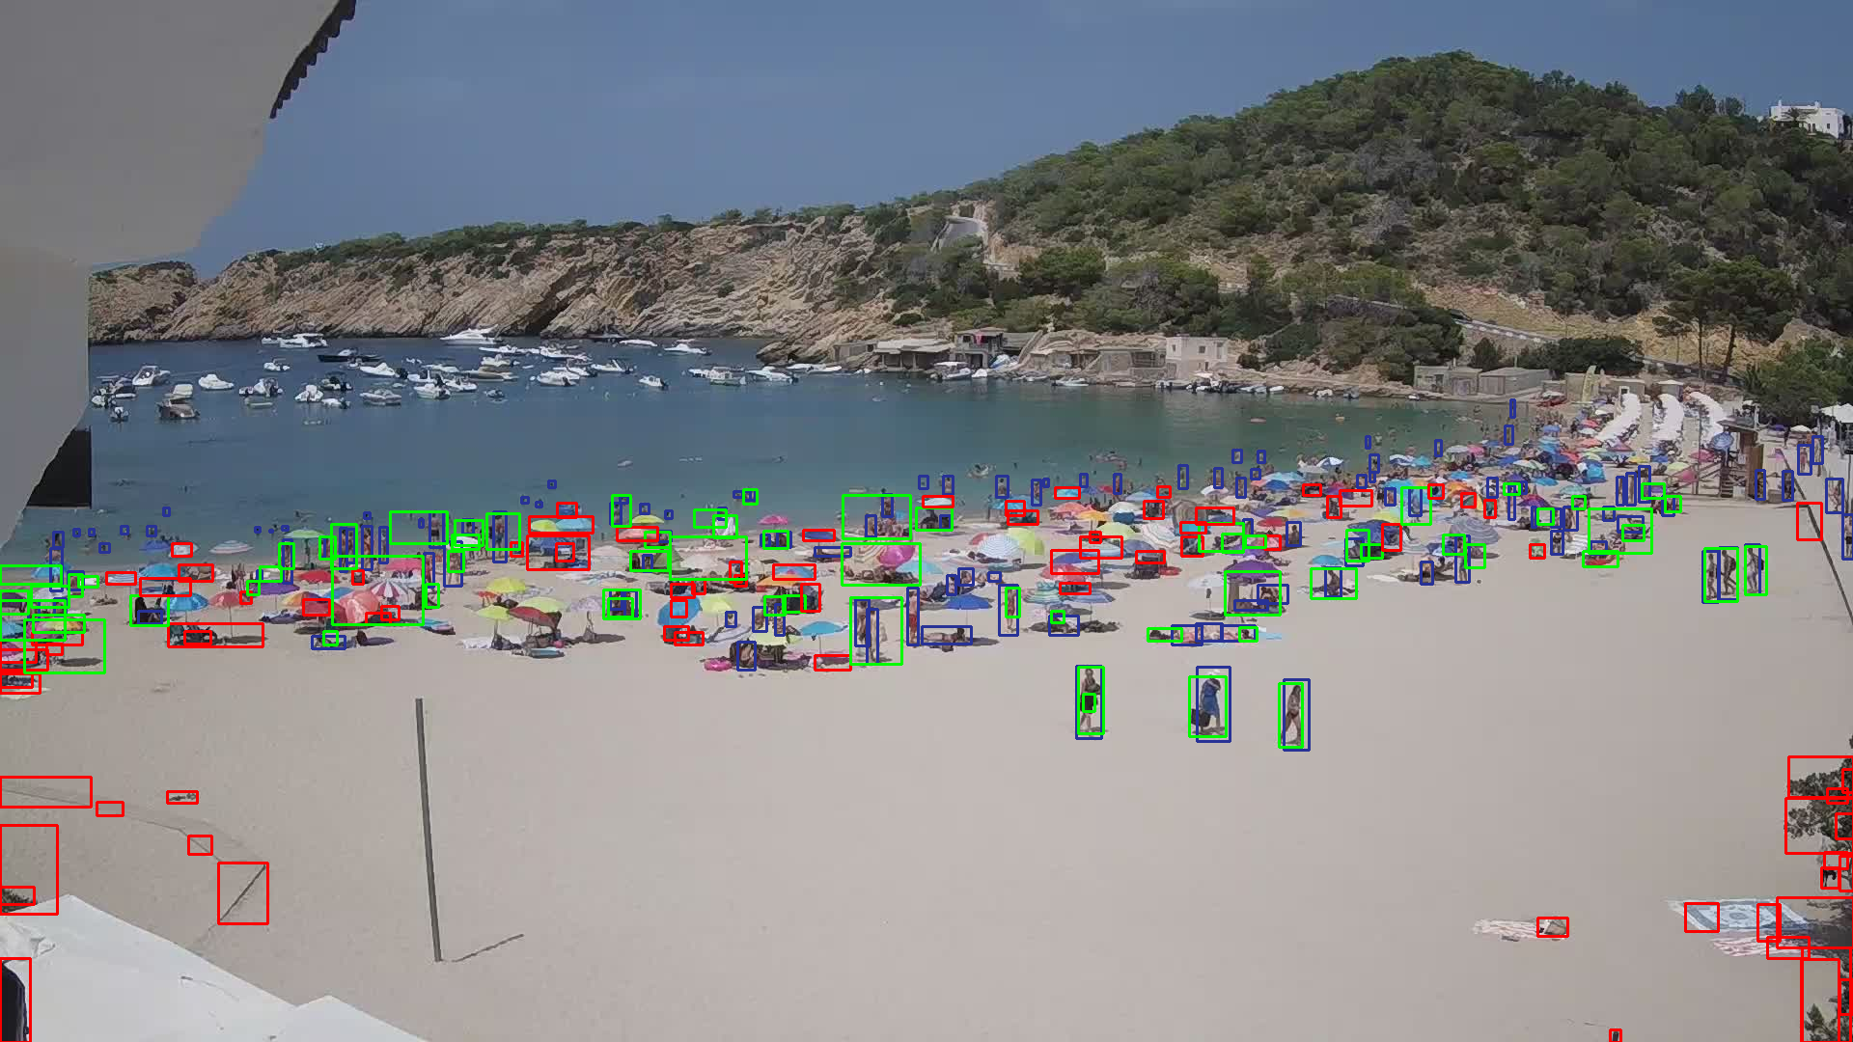
Image Analysis Project
By Melih Kurtaran

Slide 2
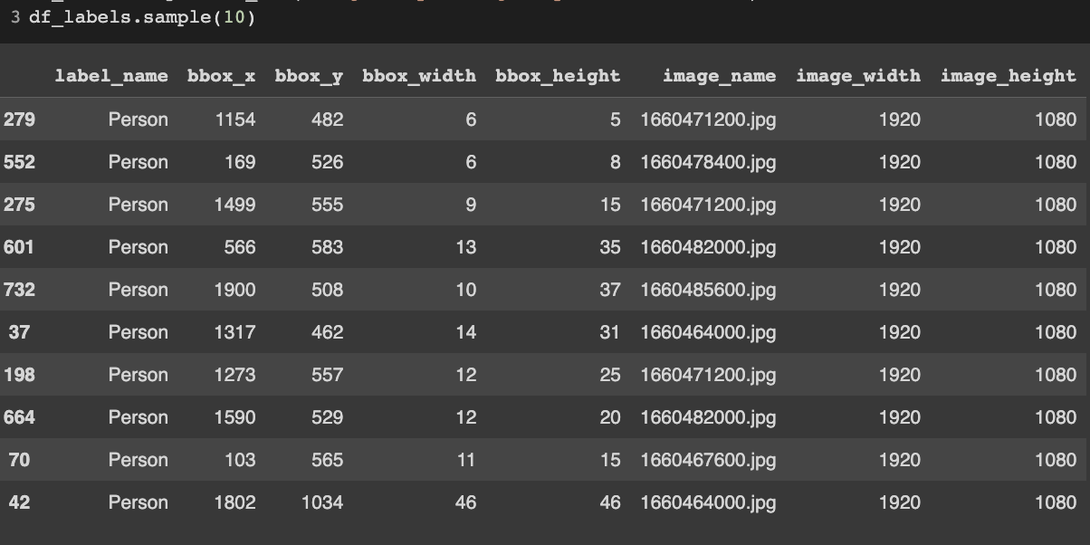
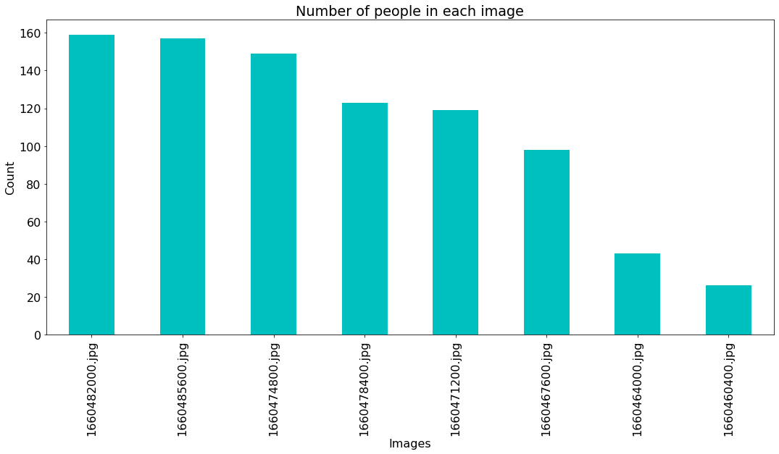
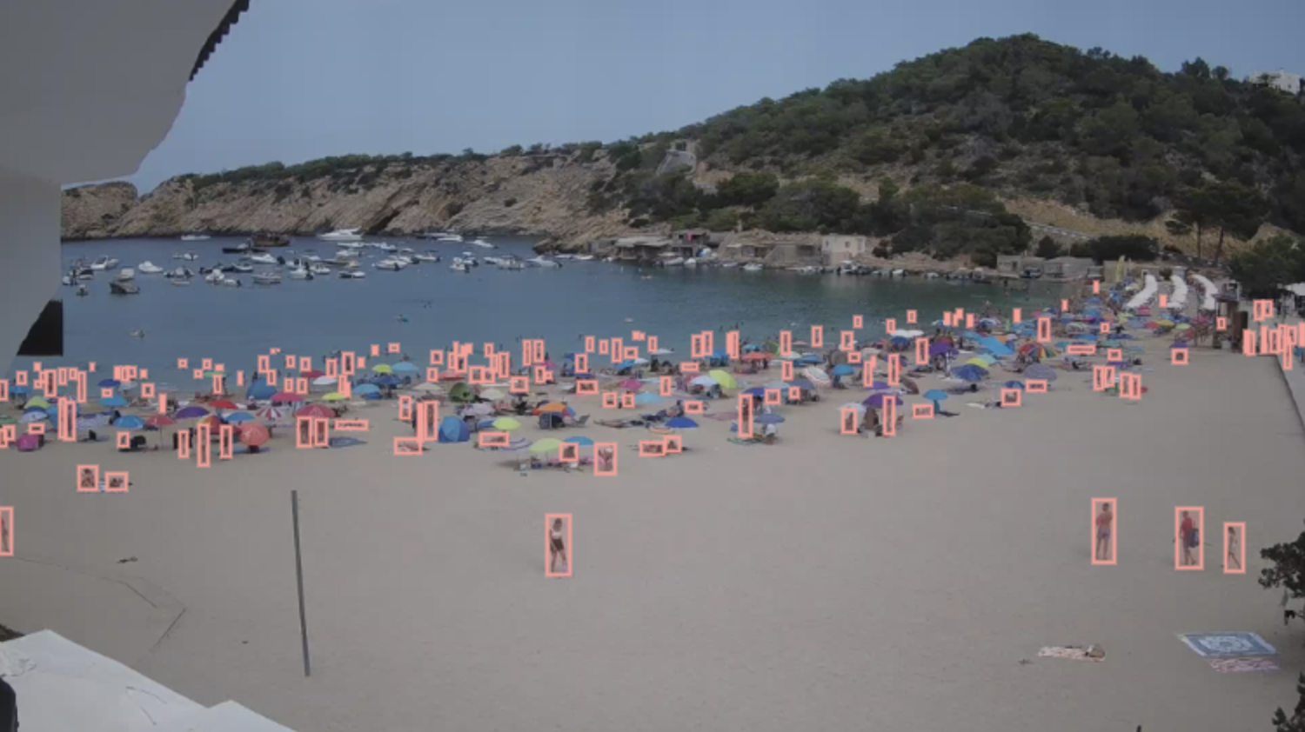
Data Annotation

Slide 3
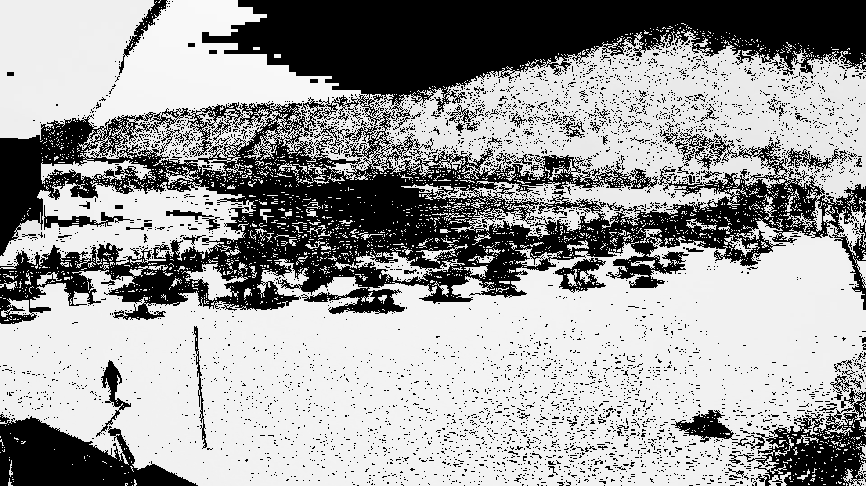
Why Pixel-wise Comparison?

Slide 4
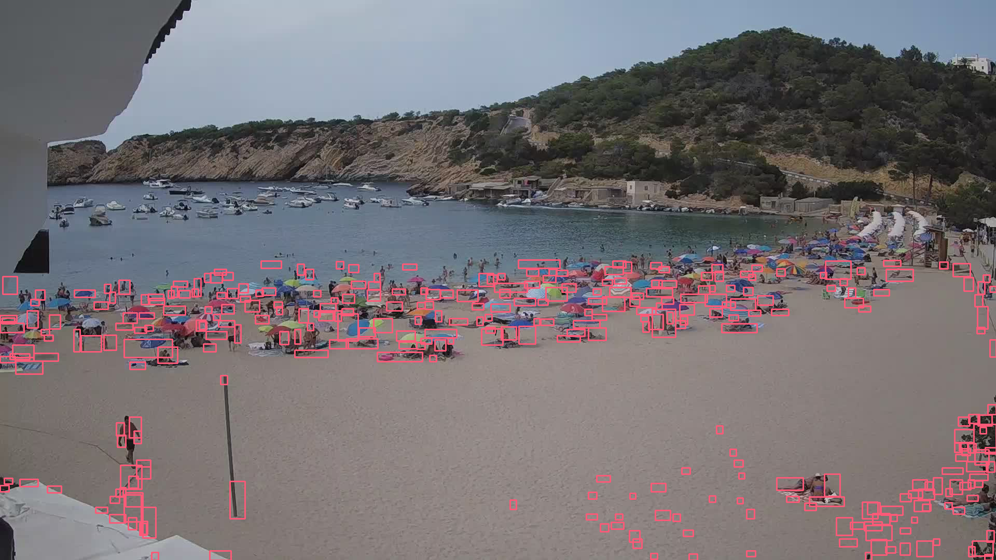
Why Pixel-wise Comparison?

Slide 5
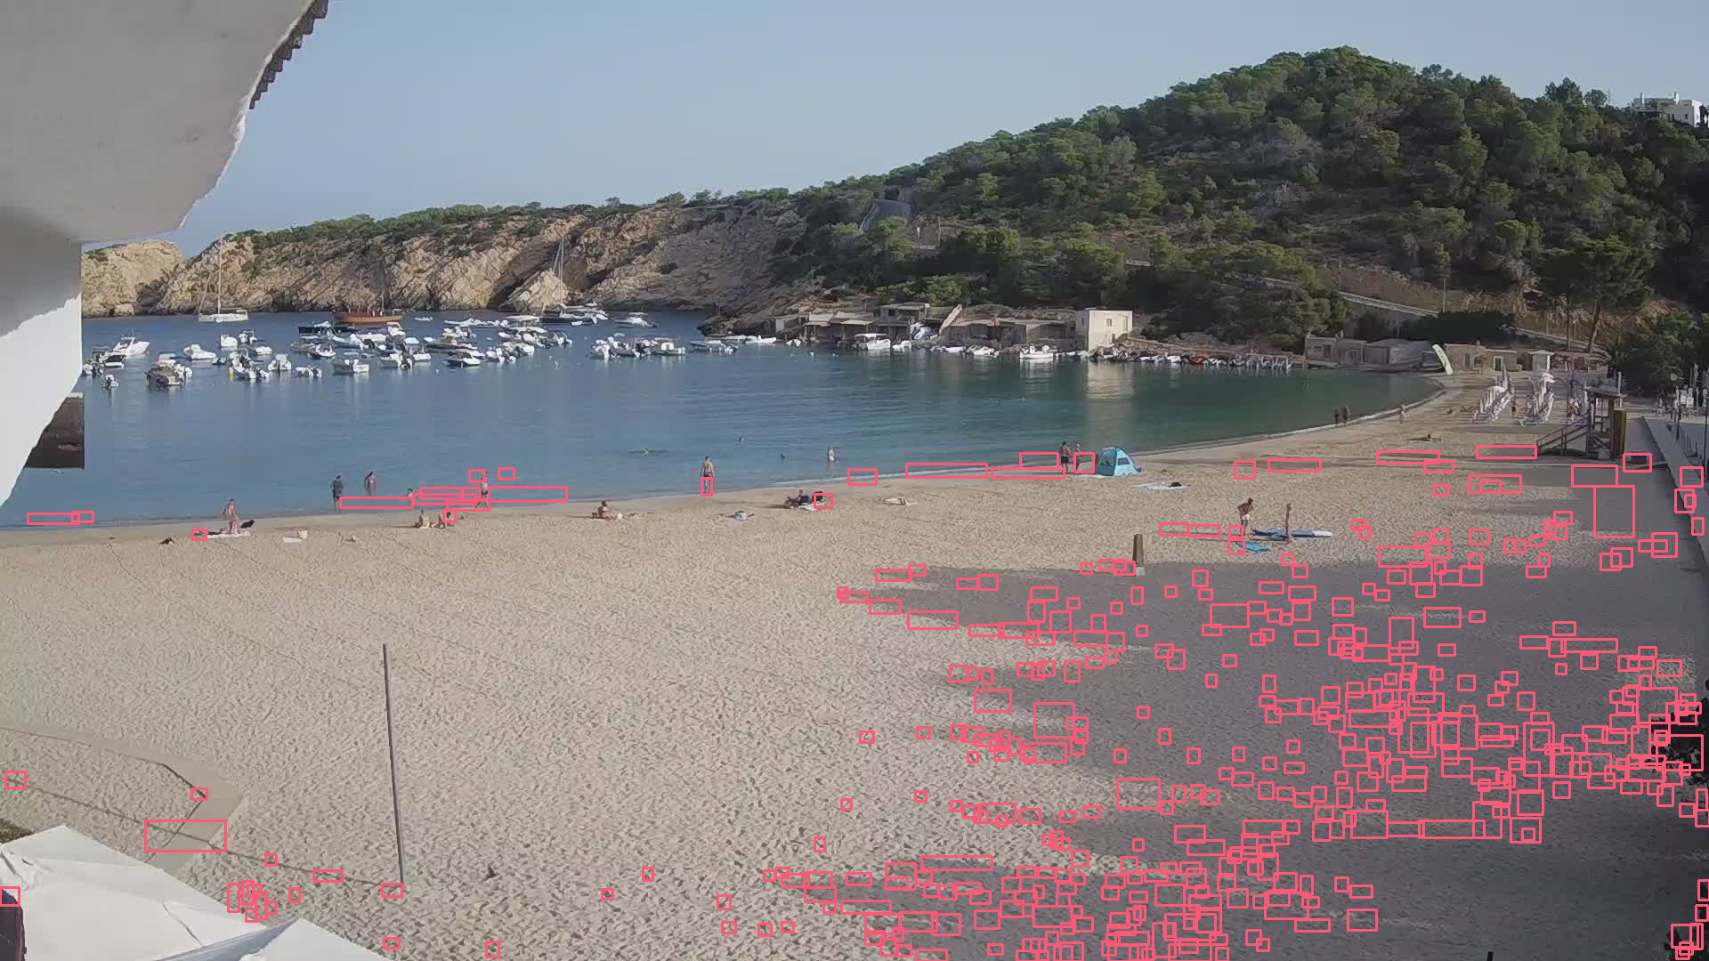
Why NOT Pixel-wise Comparison

Slide 6
Better Approach: Background Removal

Slide 7
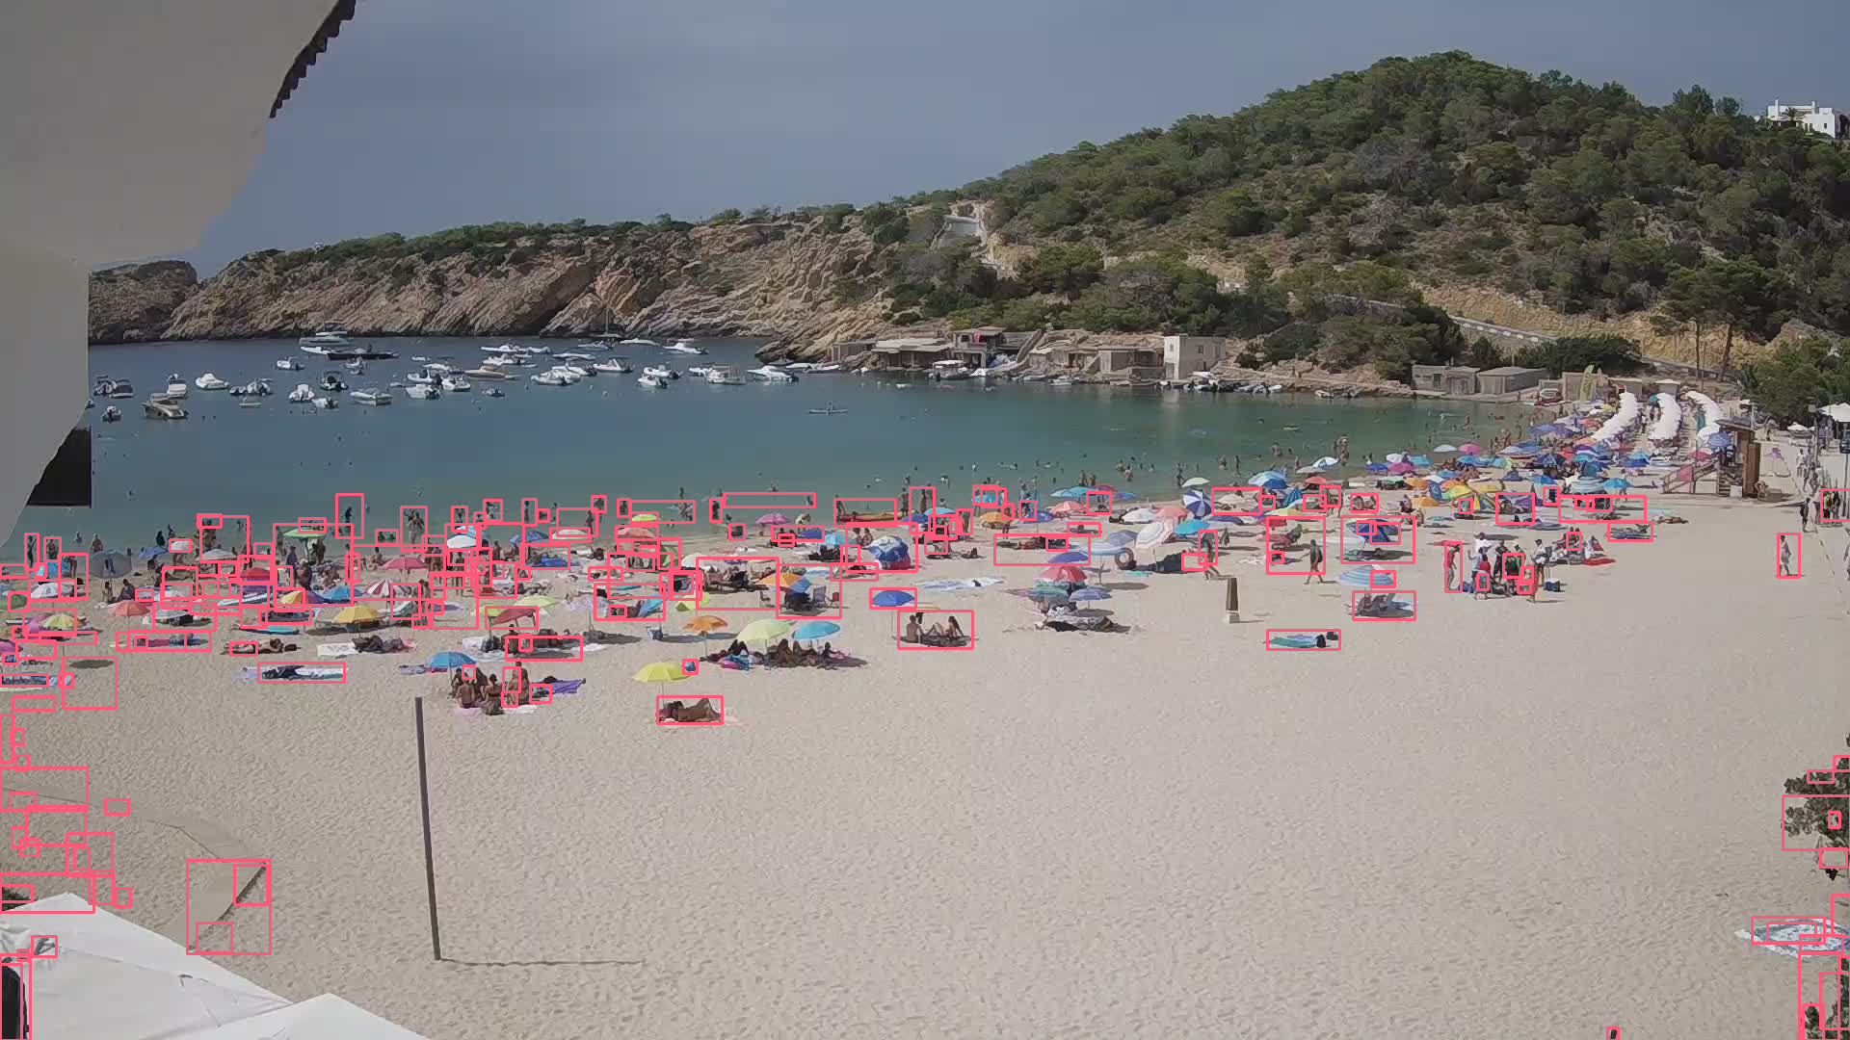
Better Approach: Background Removal

Slide 8
Pixel-wise Comparison
Background Removal
Runs very slow
Runs relatively fast
Needs an empty image of the beach
Do not need an empty beach image
Too Many False Positives
Less False Positives

Slide 9
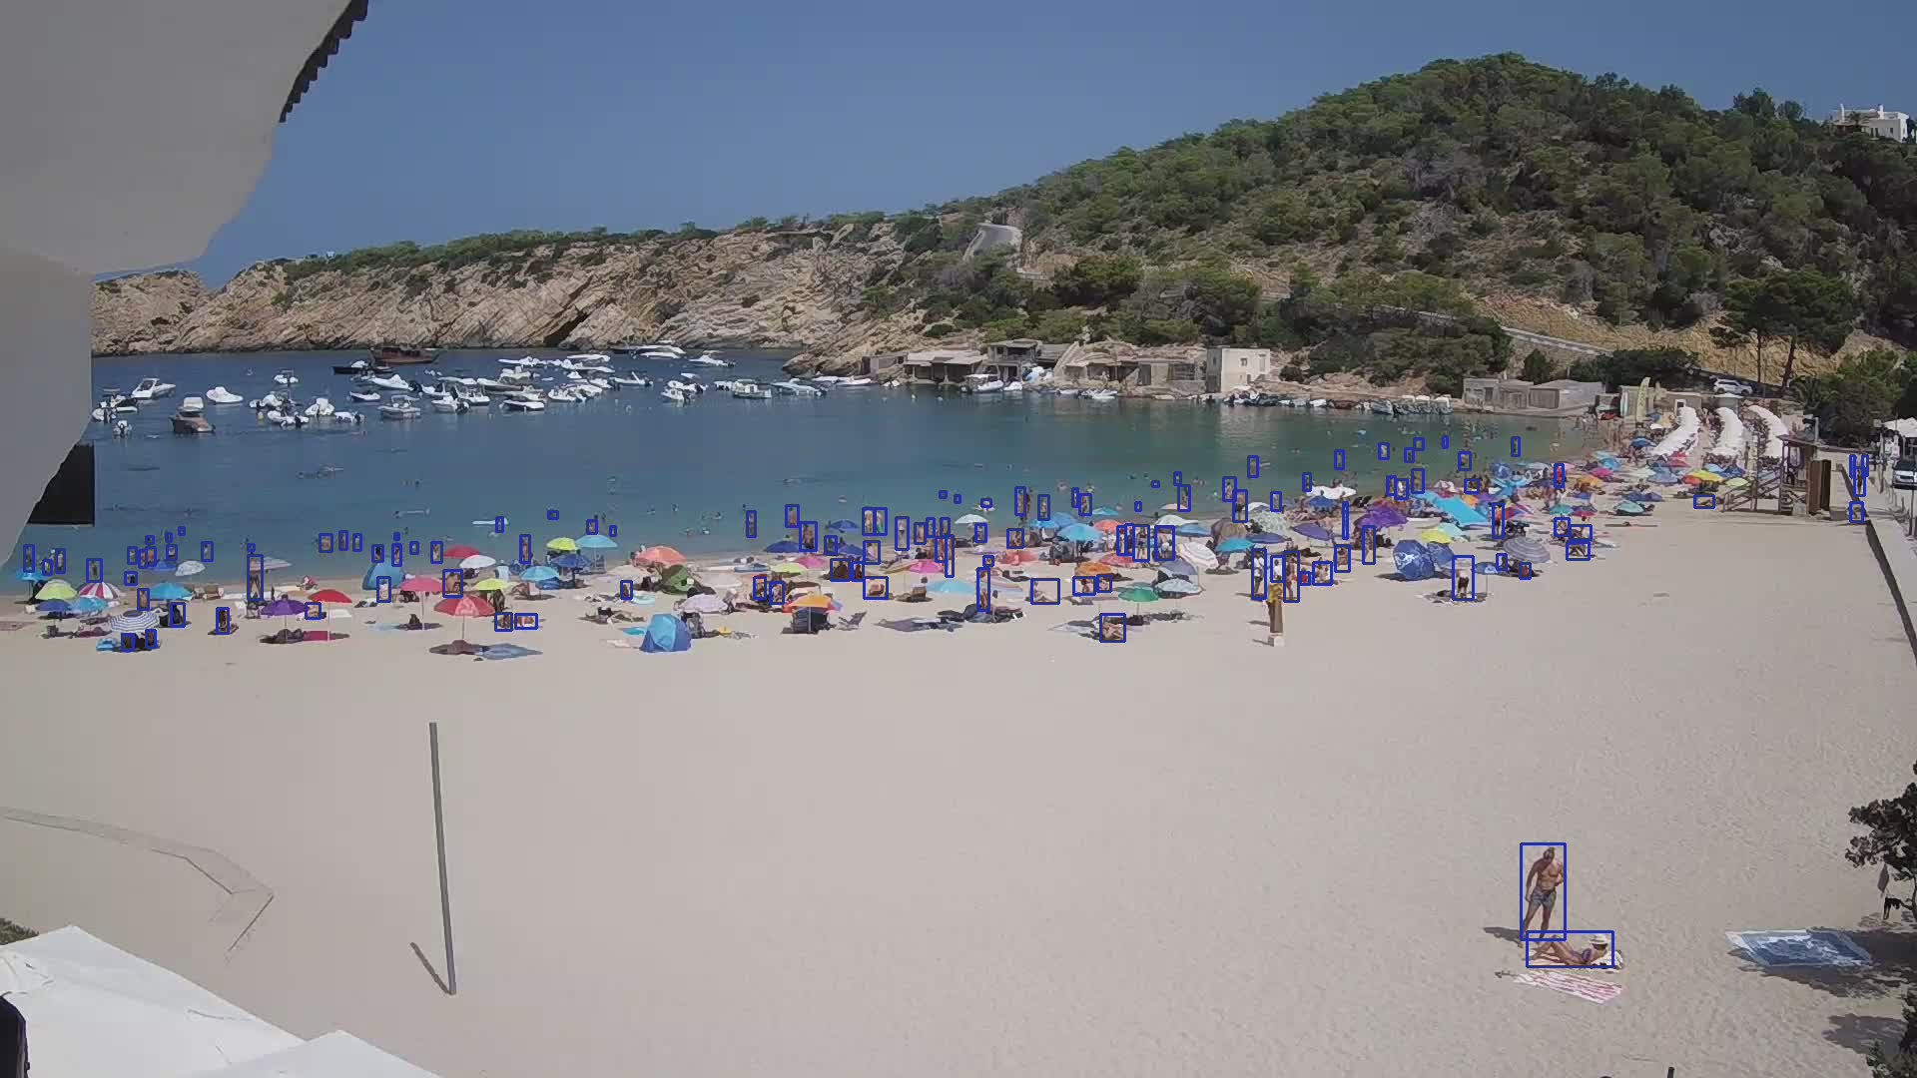
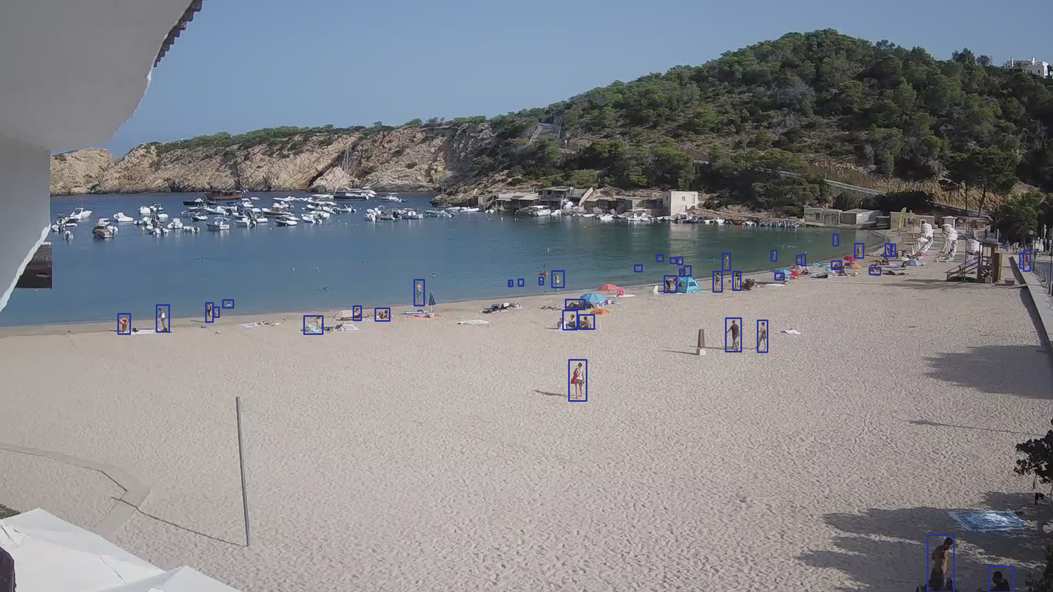
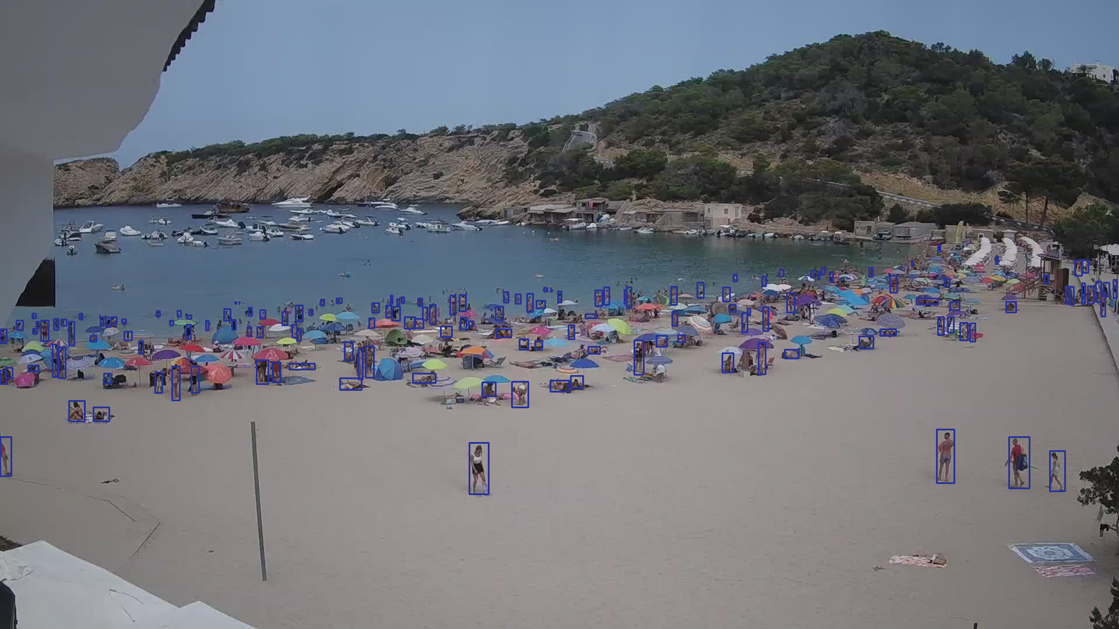
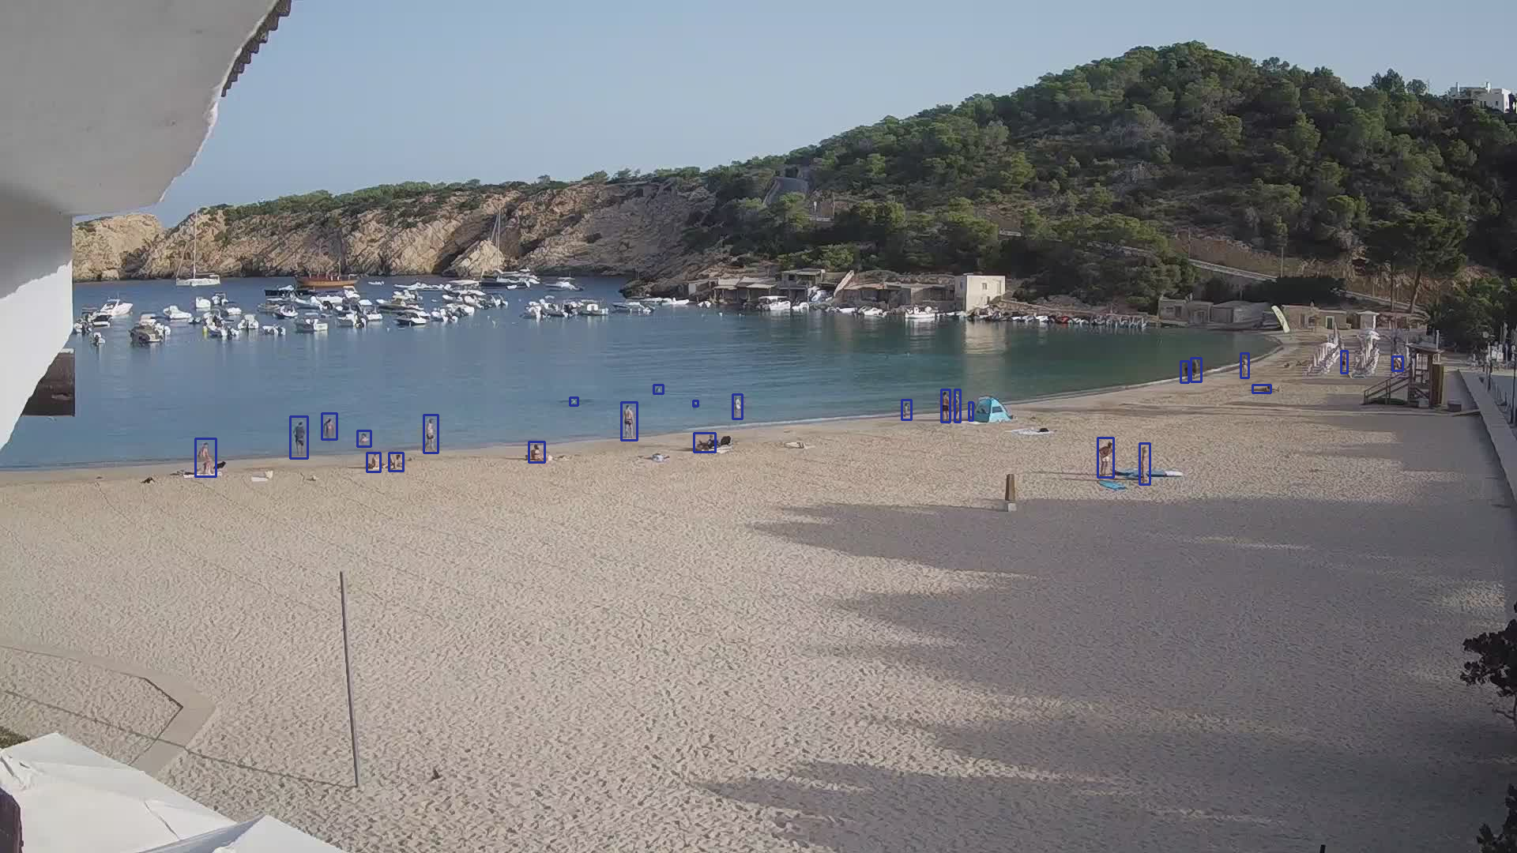
How to validate?

Slide 10
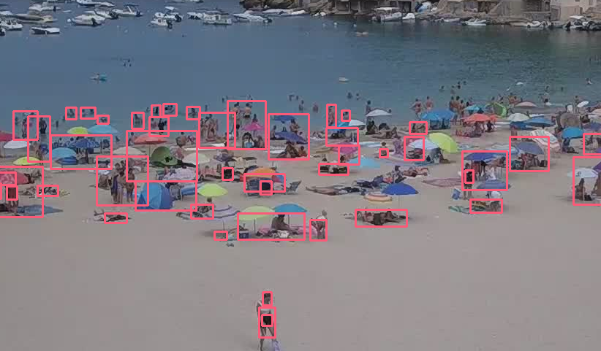
Algorithm’s results

Slide 11
The magic of box matching

Slide 12
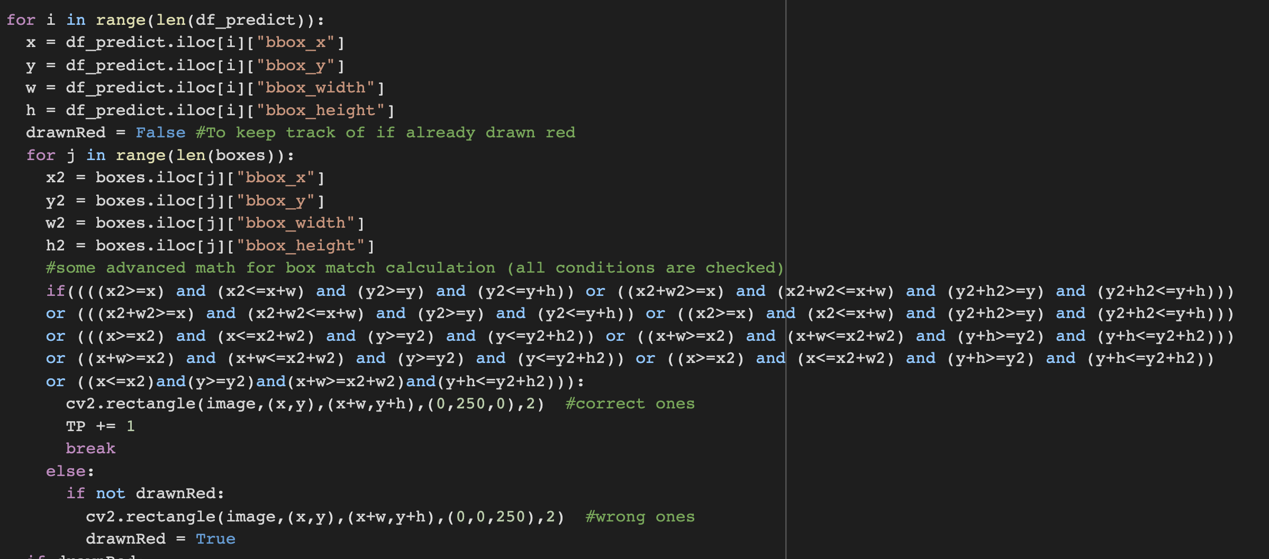
The magic of box matching

Slide 13
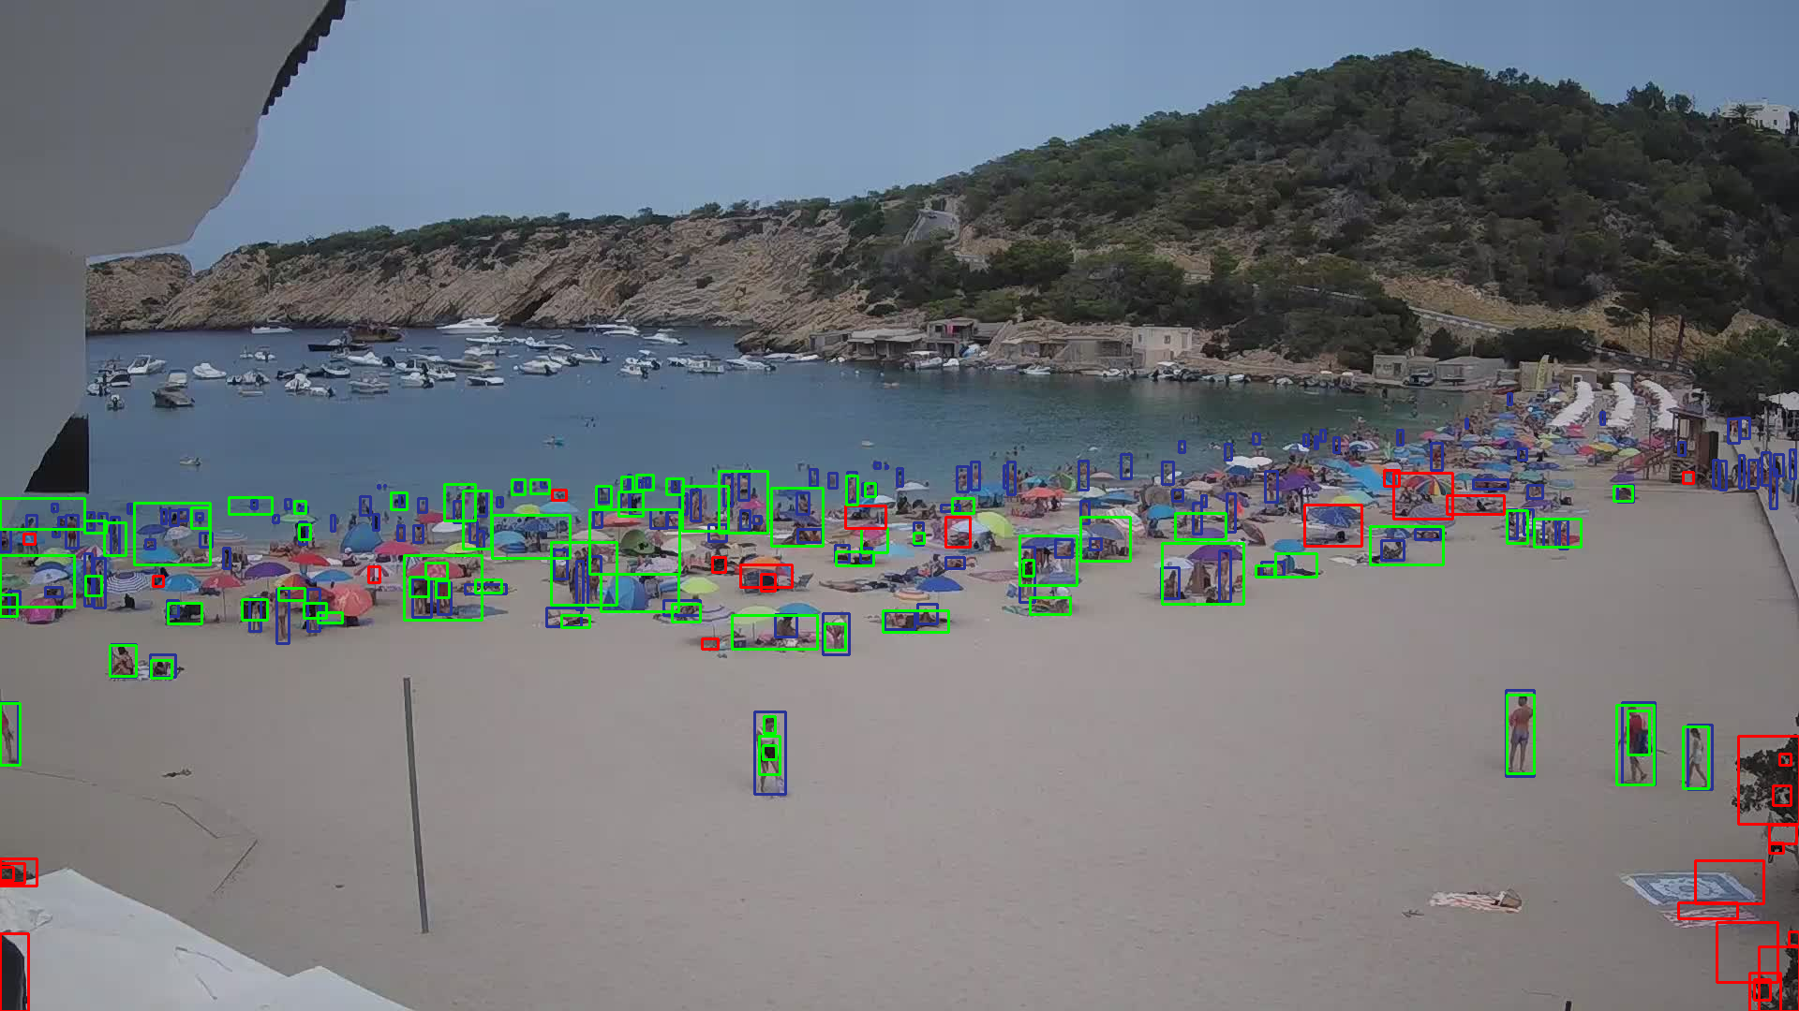
The magic of box matching

Slide 14
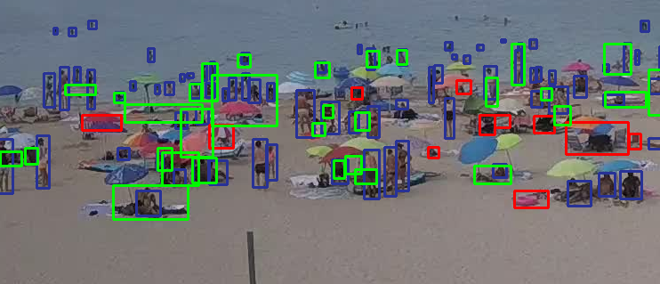
The magic of box matching

Slide 15
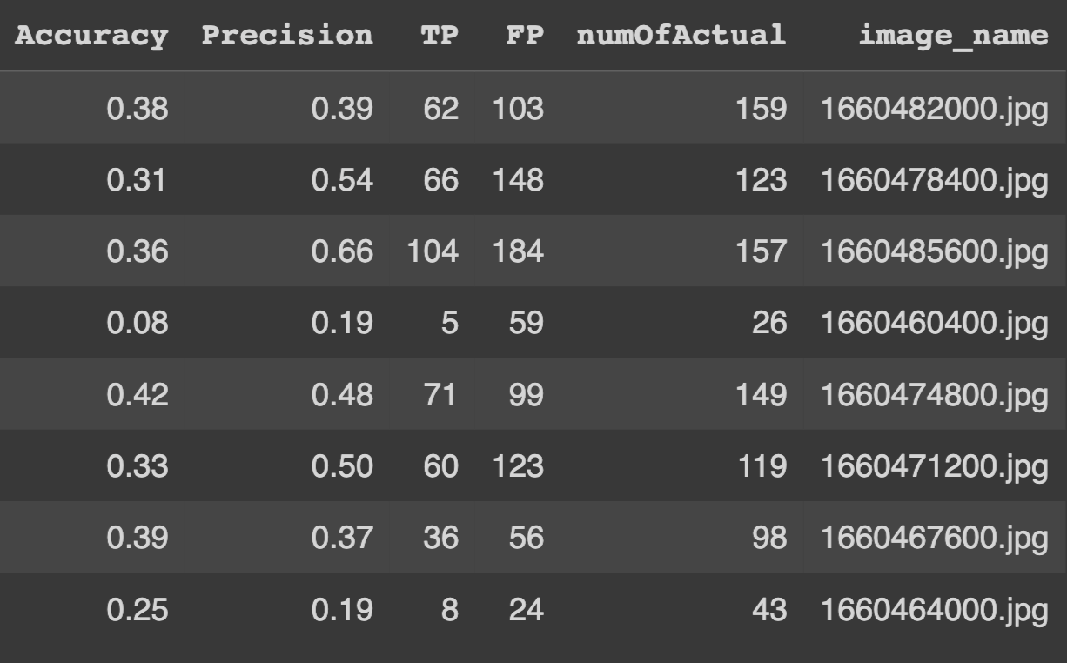
TP
TP
Accuracy =
Precision =
TP + FP
num of actuals
Average Accuracy
Average Precision
31.5 %
41.5 %

Slide 16
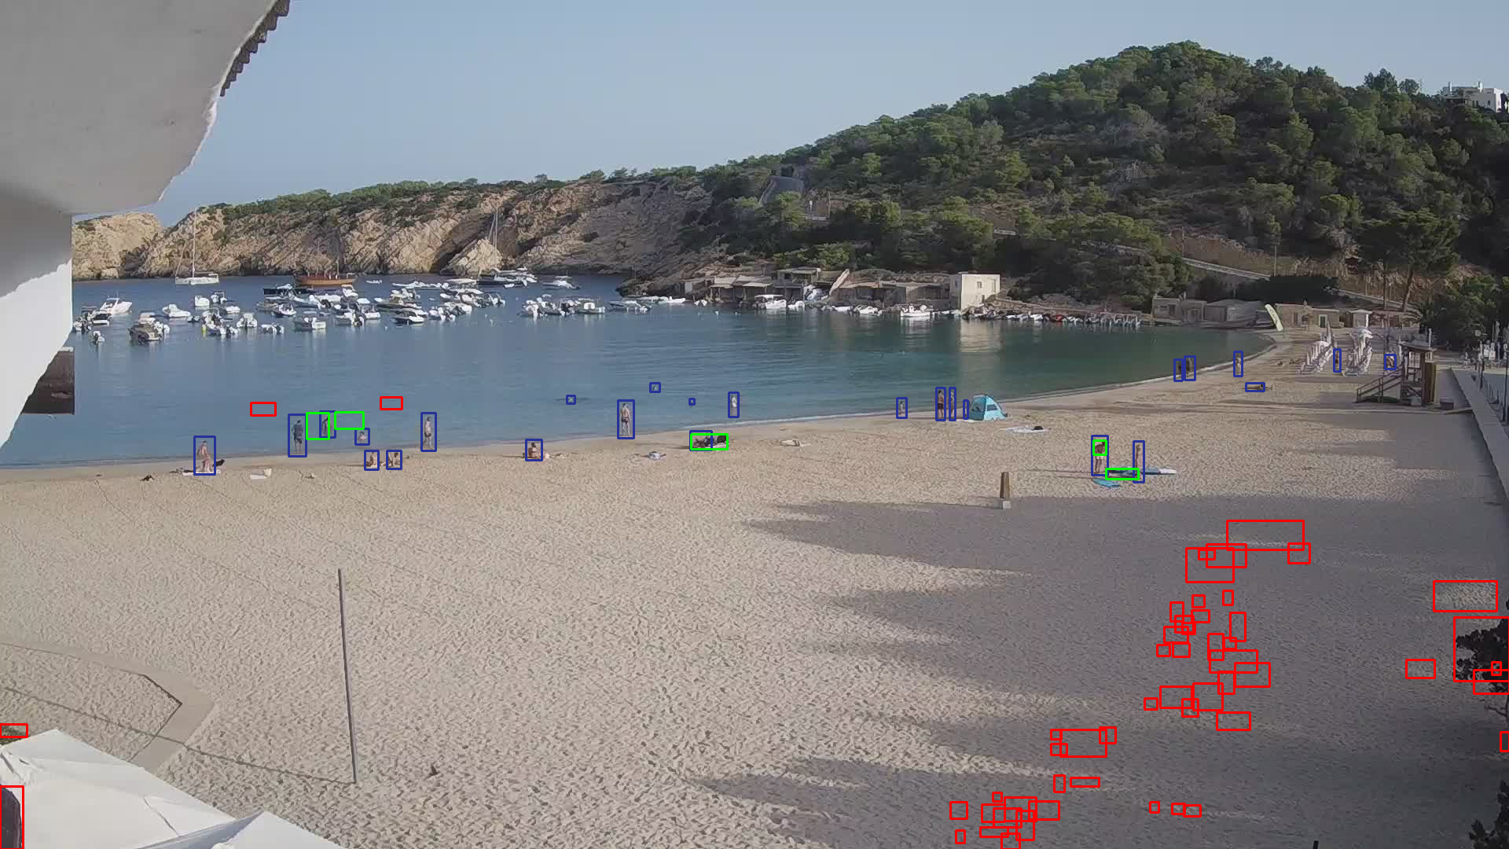
Person Level: Worst Performance

Slide 17
Person Level: Best Performance

Slide 18
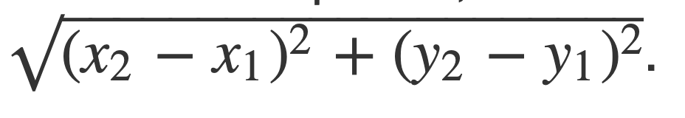
Image Level: Validation (MSE)
For each predicted box calculated based on closest actual box

Slide 19
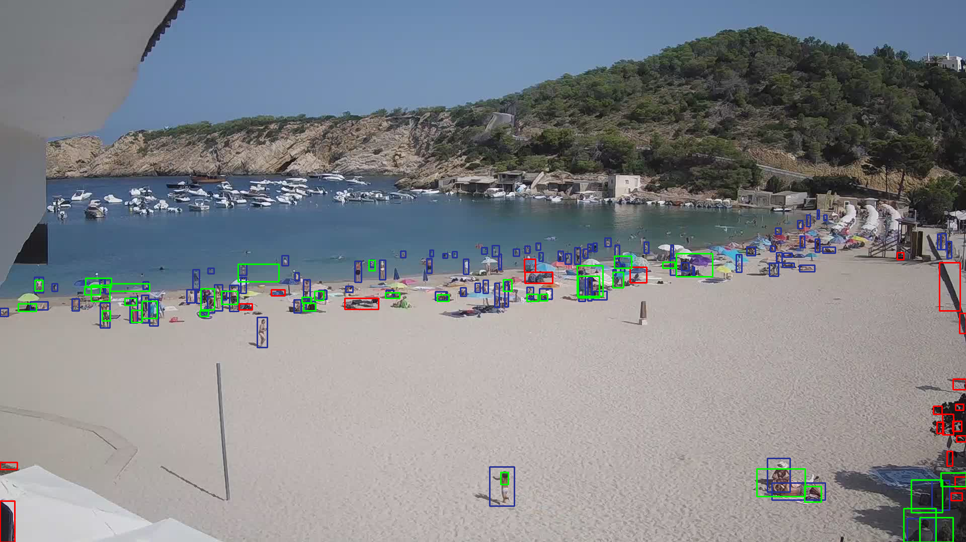
Image Level: Validation (MSE)
Best
Size of image: (1920,1080)
MSE for image 1 is 8.5104145378
MSE for image 2 is 50.395124613
MSE for image 3 is 58.286825078
MSE for image 4 is 283.01616047
MSE for image 5 is 26.164329392
MSE for image 6 is 15.307548531
MSE for image 7 is 5.3235438584
MSE for image 8 is 11.645002907
Worst
Average MSE = 57.331

Slide 20




THANK YOU!
@melihkurtaran
Melih Kurtaran
@MelihKurtaran
melihkurtaran@gmail.com

